Slide 1

Neemrana Circle
Moksh Gupta | moksh.gupta@st.niituniversity.in
Nikhil Gahlot | nikhil.gahlot@st.niituniversity.in
Yash Agrawal | yash.agrawal@st.niituniversity.in
Gaurav Mundhra | gaurav.m@st.niituniversity.in
Deeptonabho Dutta | deeptonabho.dutta@st.niituniversity.in
Amanpreet Singh | amanpreet.singh@st.niituniversity.in
Shubham Tripathi | shubham.tripathi@st.niituniversity.in

Slide 2
Description
Neemrana Circle website is designed for providing a local search for different types of services in Neemrana. The website can also be viewed in mobile mode and has been coded in HTML5, CSS, and JavaScript along with the use of Java and MySQL for back-end and database.
The user will be able to navigate through the website with button tabs on a web-based system.
There are only two users, first is an Admin and second a user who can access the whole website except the admin functionalities. Admin will be authenticated every time before using admin functionalities.

Slide 3
Features
1. Admin login
2. Admin Dashboard which gives the admin all the privileges
3. Home Page View listing all the categories
4. Shop Grid View shows all the shops of a specific category
5. Full page view shows all the details of a particular shop with pictures of that shop, shop items, menu, etc
6. A search bar on every page that searches data on basis of the page the user is currently on

Slide 4
Security Features
The website is fully secured from attacks such as
SQL injection, and
XSS

Slide 5
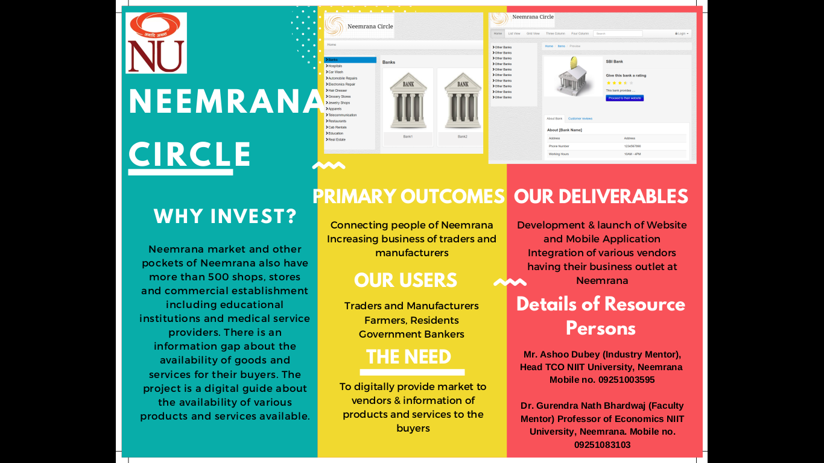
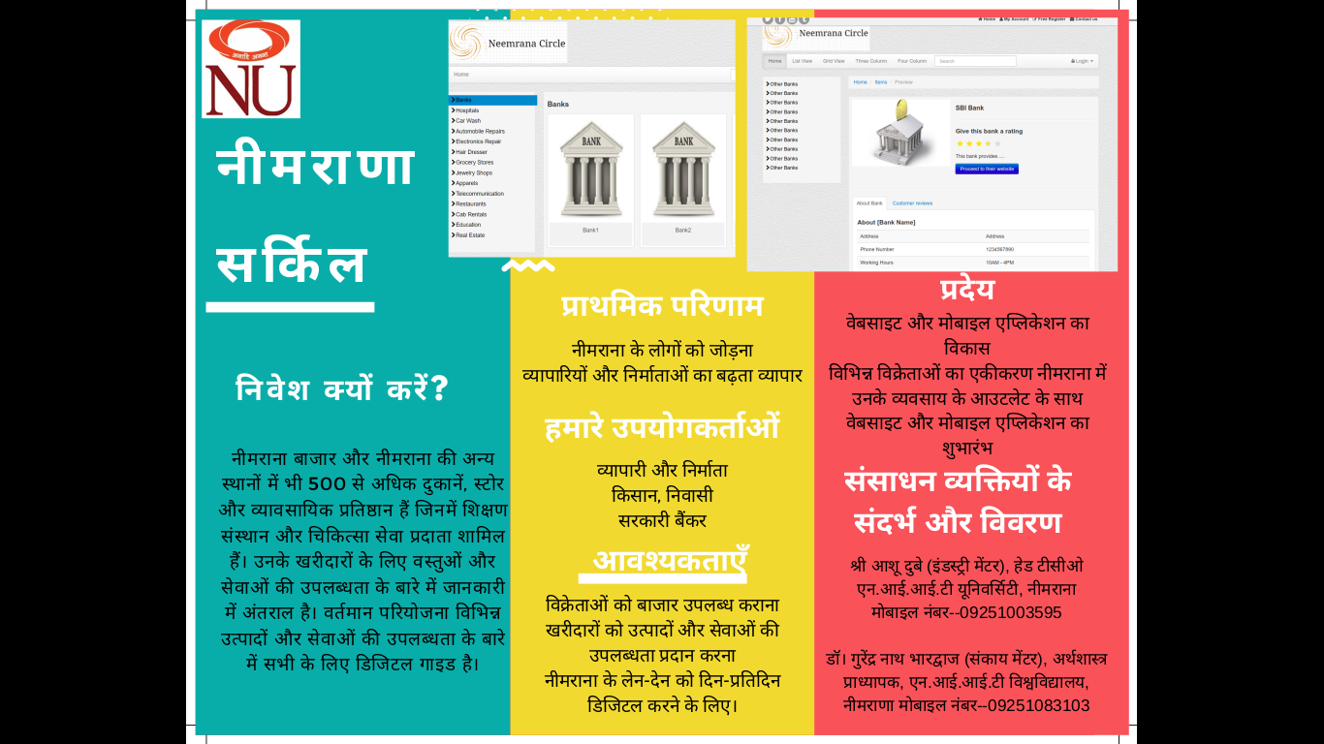
Brochure (Hindi) (English)
(English)
(Hindi)

Slide 6
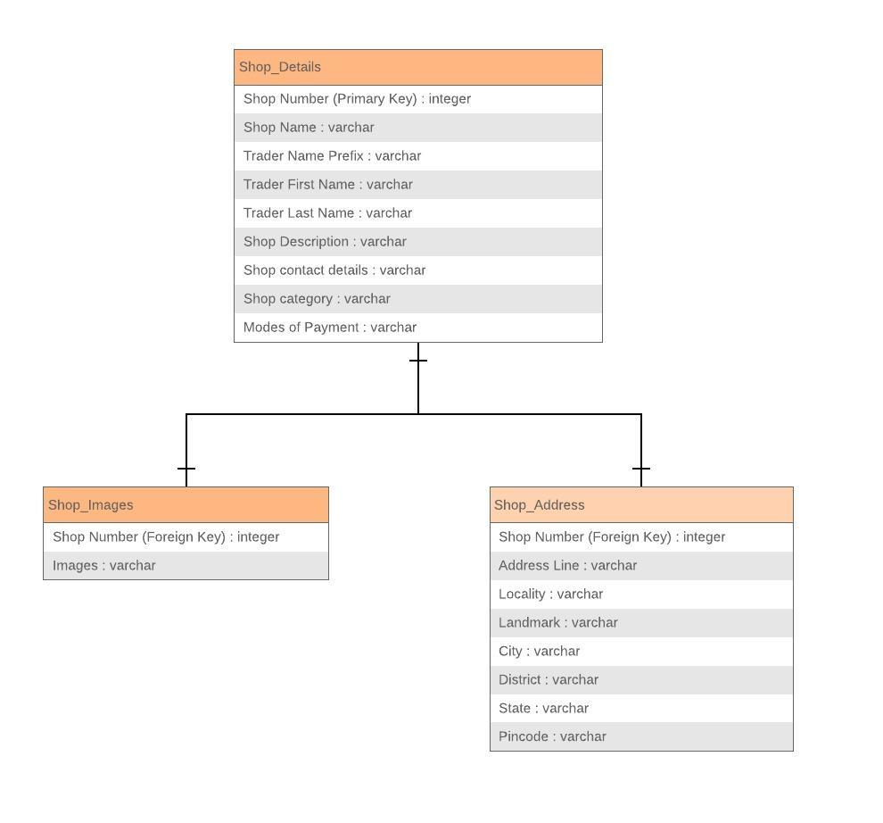
ER Diagram

Slide 7
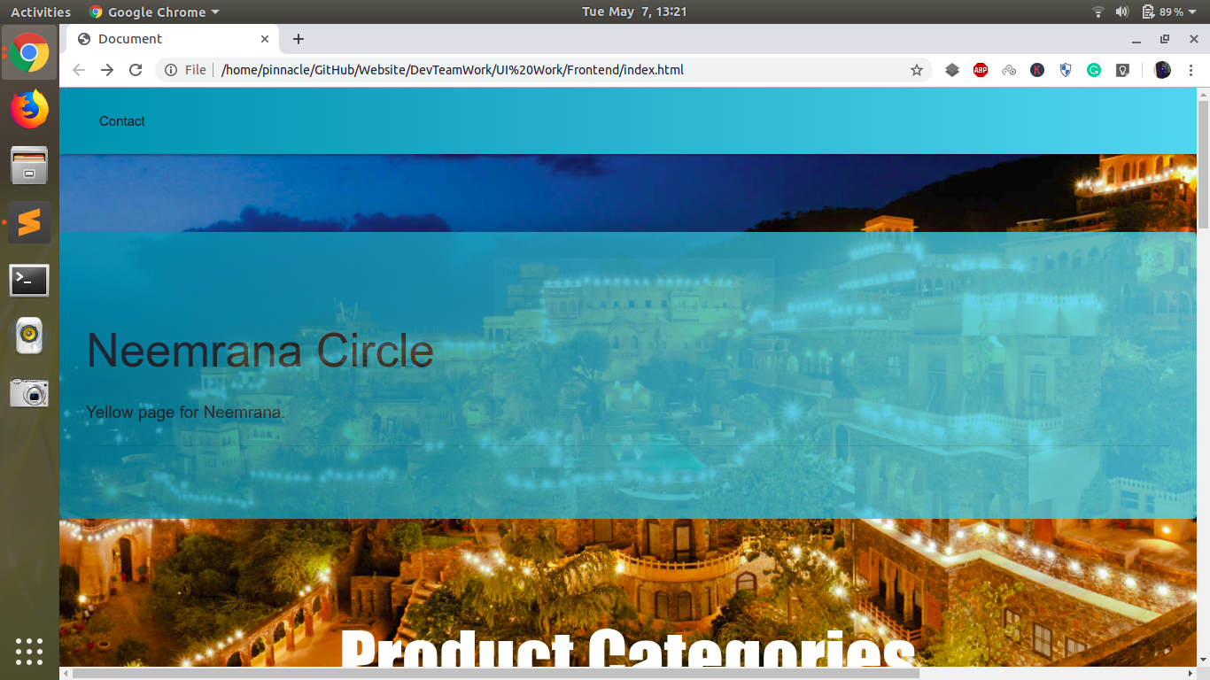
Home Page

Slide 8
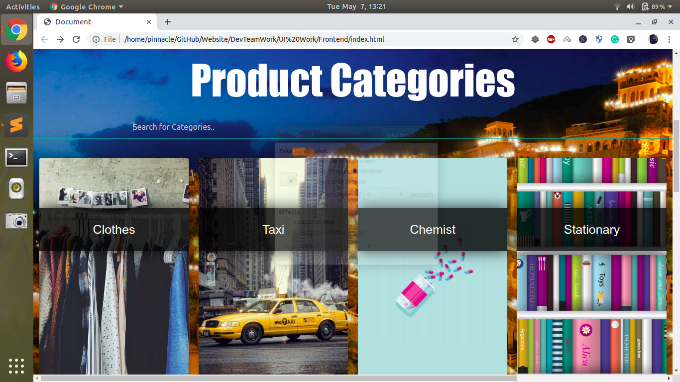

Slide 9
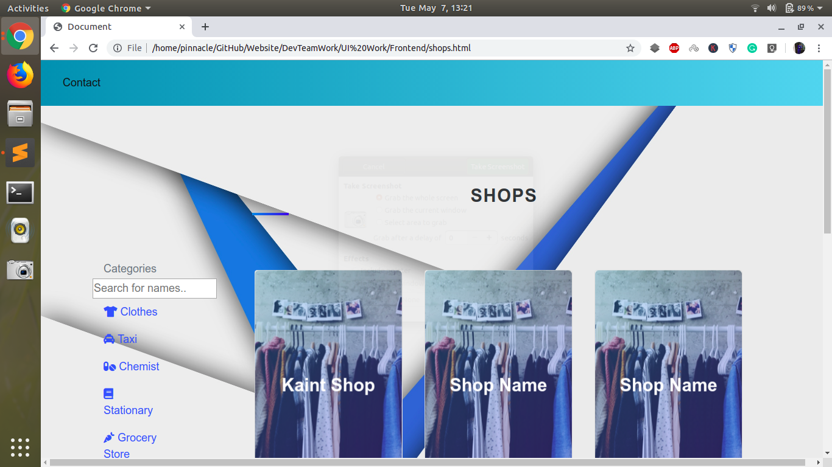

Slide 10
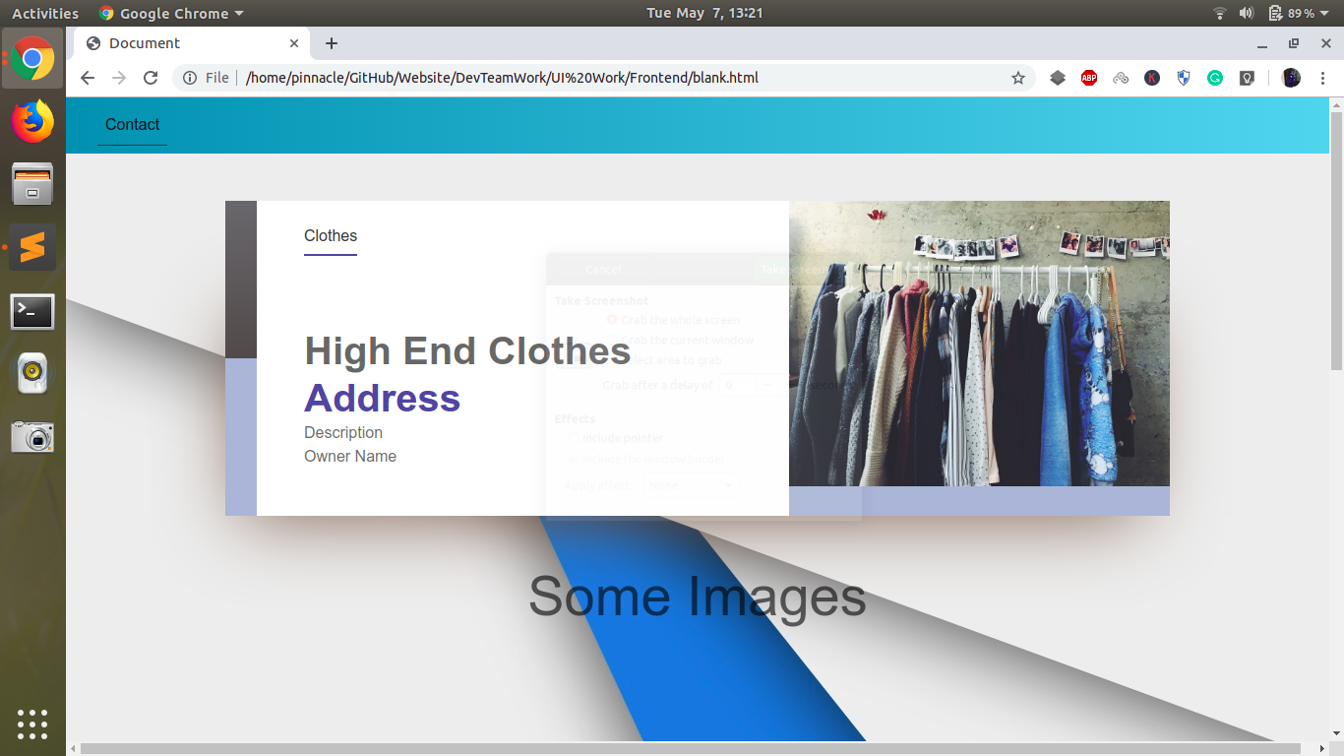

Slide 11
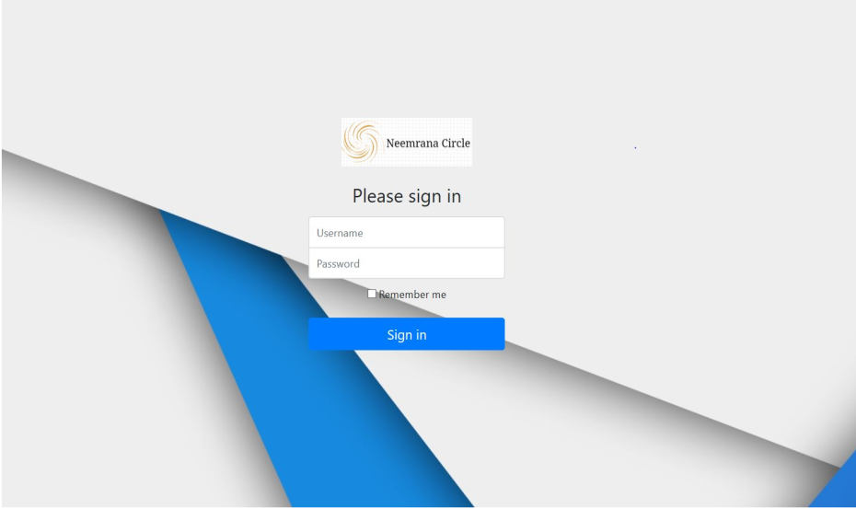
Admin Login

Slide 12
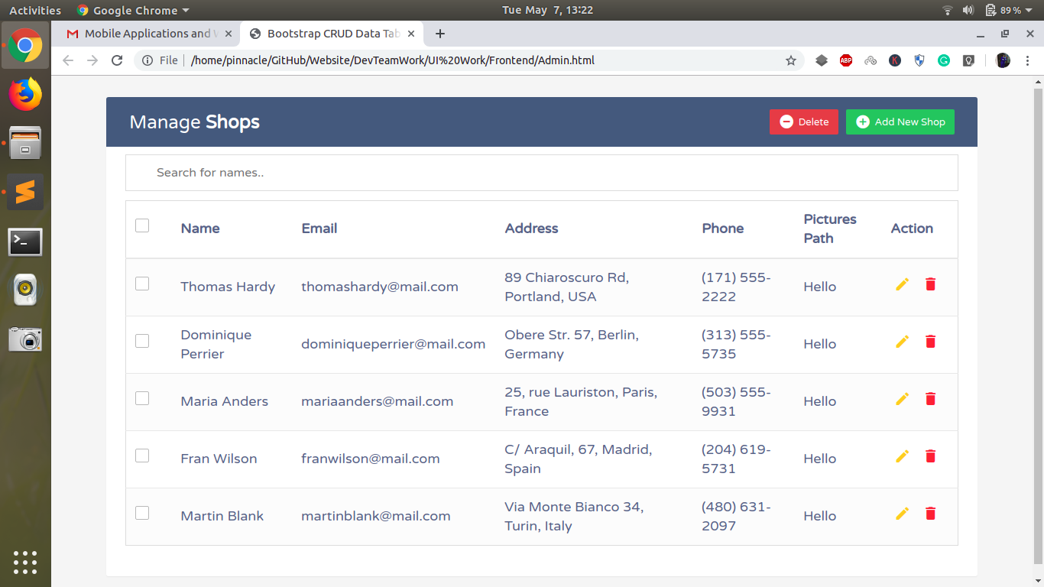

Slide 13
Thank you!

